Slide 1

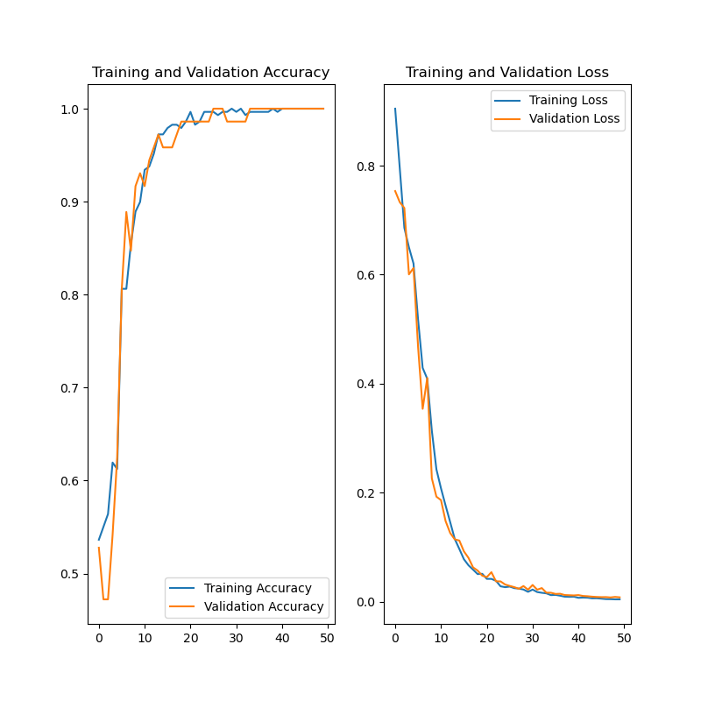
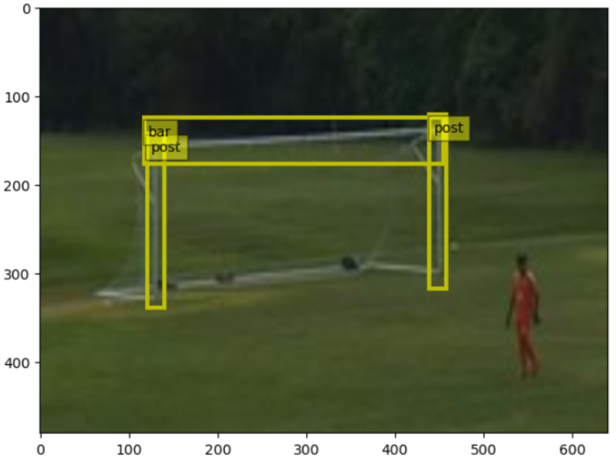
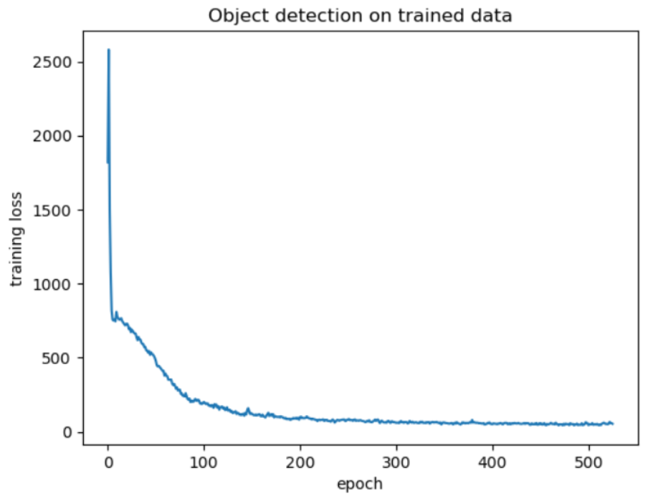
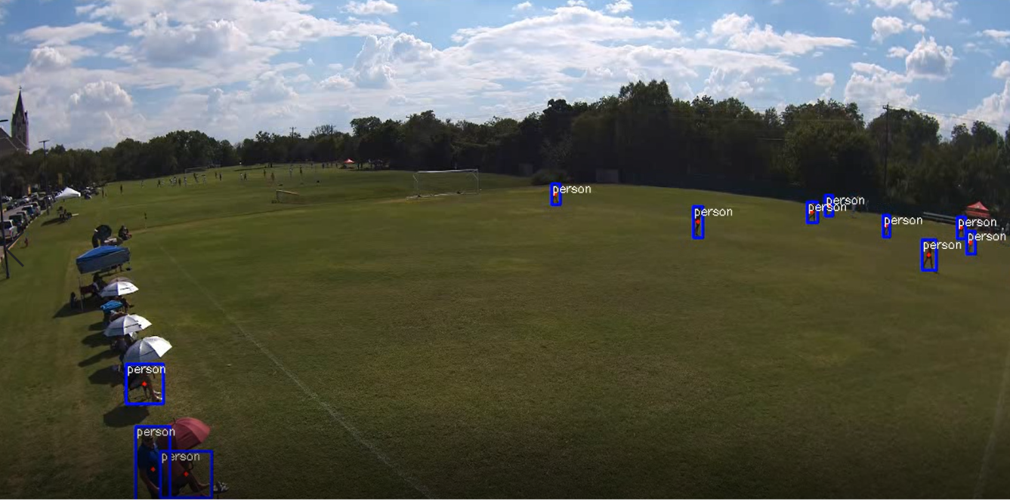
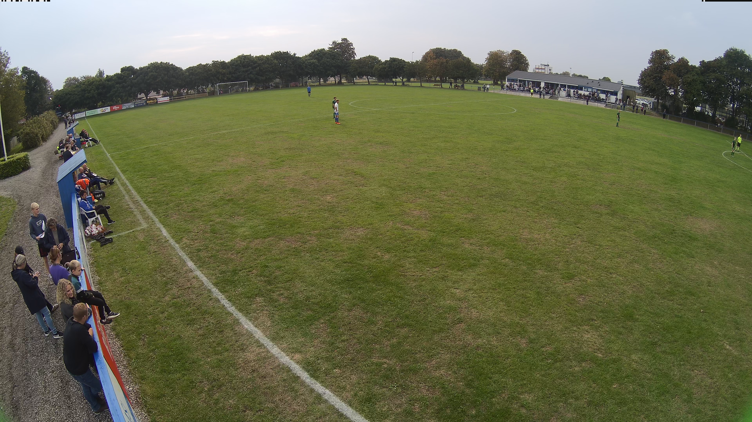

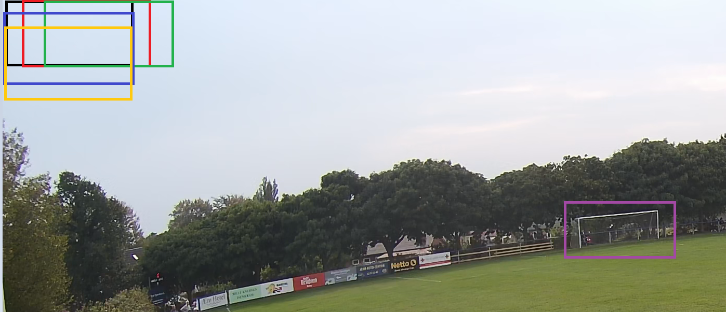
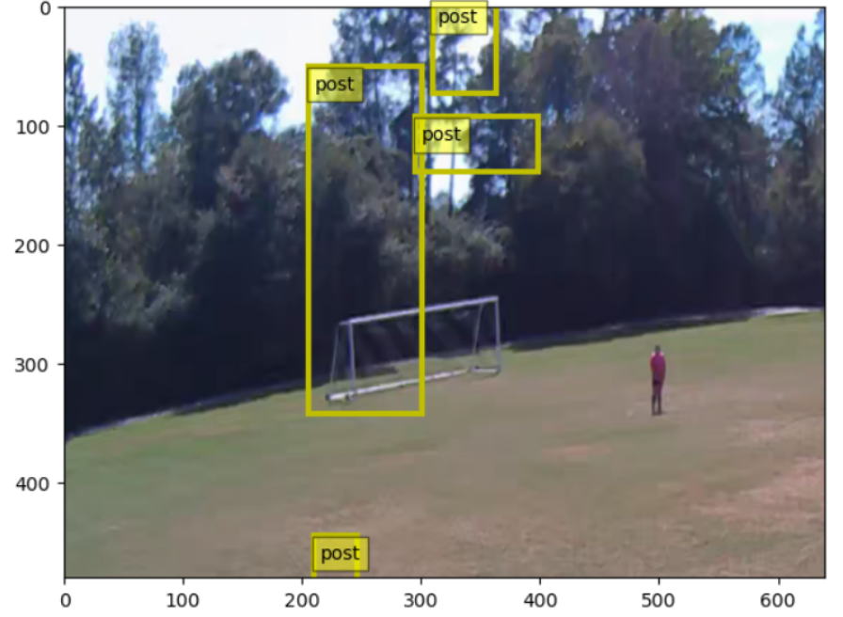
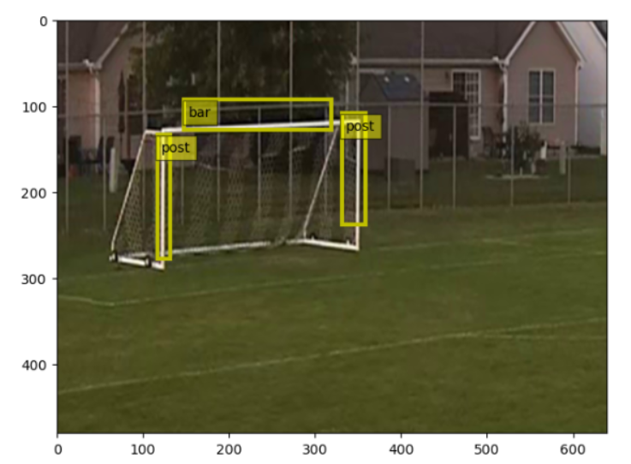
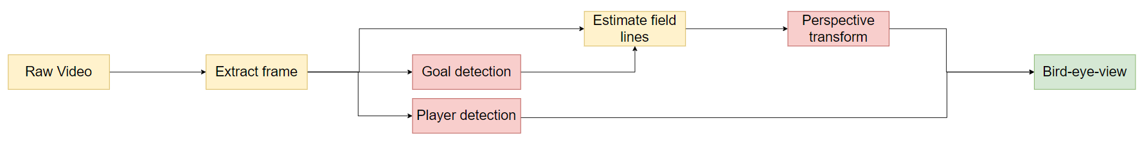
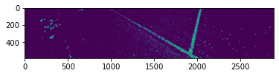
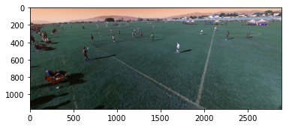
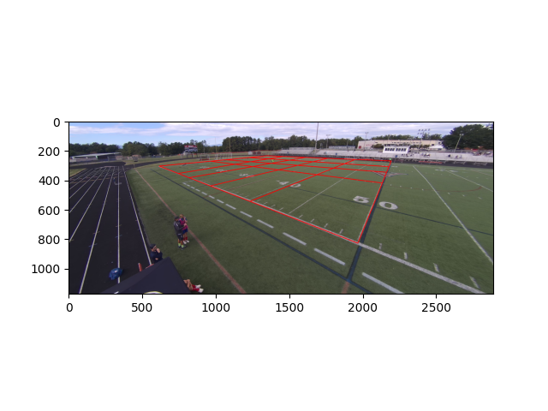
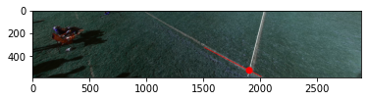
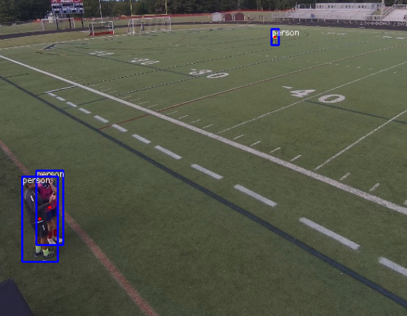
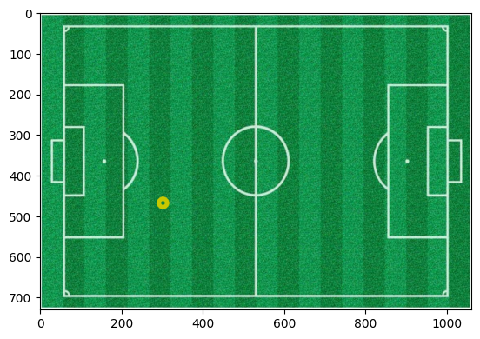
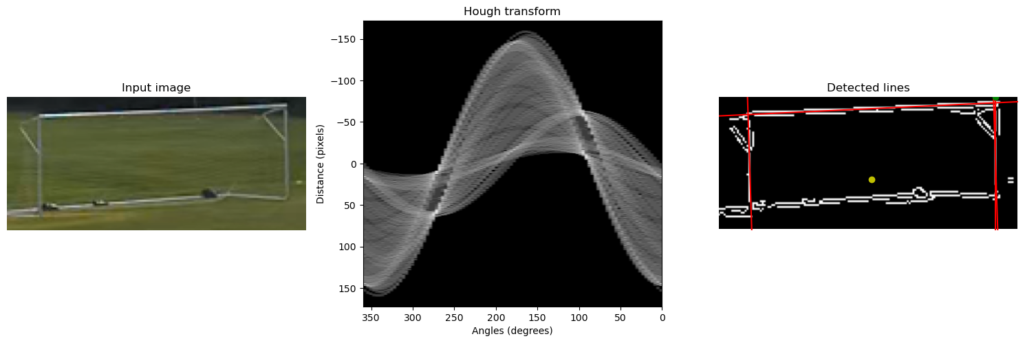
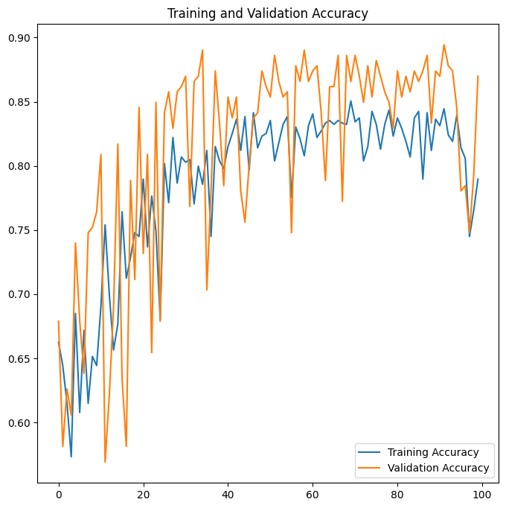
Deep Learning Estimation of 2D Position of Football Field Elements and Players – VEO
Samuel Poltock(s212973), Paweł Zieliński (213231), Vilhjálmur Kári Jensson (212942), José Turégano Pérez (212751), Thor Larsen (171198) DTU Electro, Technical University of Denmark
Introduction
Finding the goal
Image Classification
Object detection
The project proposal was quite open-ended as it only states to apply deep learning on the Veo project. The goal was to create a system capable of detecting players and the field and then be able to apply a prospective transformation to show the position of players on a 2d field. The project can be divided into three general sections. Deep learning models were applied in every section to different extents.
Data Creation:
- Goal/Not goal
- Data from web and VEO data
Model: CONVx3, 1 dense
Results:
- Training and validation shows good results, however predicting on VEO data doesn't perform as well.
Goal
Data Creation:
- Images+(labelled)XML files
- Data from web and VEO
Model:
- Two Stage Detector
- Extract regions
- Classification module
Player detection
- Results:
- YOLOv7
Image tiling:
Veo
Training set Image
- Precreated neural network to objects in an image
Model
FieldLine detection
Pre-processing
Perspective transform
Conclusion
Original image
Data pre-processing:
Un-Distortion
Data Collection and Correlation:
LineGrid
Data Processing
Undist.
Collection of individual tools -> Potential to add value to Veo’s software subsription solution
Proof of concept -> solution needs added robustness to be before release to the public
Hardware Upgrade -> better software performance
​
Intersection detection
Detecting the middle of the goal
- Opencv.GetPerspective ​
- SVD – ML(MSE)​
- Vanilla Neural Network​
​
Problems:​
- Low-Definition for far points, Sigle Camera view
References
[1] heartexlabs, “Labelimg,” https://github.com/heartexlabs/labelImg, 2022. [2] Shaoqing Ren, Kaiming He, Ross Girshick, and Jian Sun,“Faster r-cnn: Towards real-time object detection with region proposal networks,” 2015. [3] Chien-Yao Wang, Alexey Bochkovskiy, and Hong-Yuan Mark Liao, “Yolov7: Trainable bag-of-freebies sets new state-of-the-art for real-time object detectors,” 2022. [4] Veo.com
Notes:
1

